Slide 1





Electronic Commerce Payment Systems

Slide 2
Learning Objectives
Understand the shifts that are occurring with regard to online payments.
Discuss the players and processes involved in using credit cards online.
Discuss the different categories and potential uses of smart cards.
Discuss stored-value cards and identify under what
circumstances they are best used.

Slide 3
Learning Objectives
Describe the situations where e-micropayments are used and the alternative ways for handling these situations.
Describe the processes and parties involved in e-checking.
Understand the major types of mobile payments.
Describe payment methods in B2B EC, including payments for global trade.

Slide 4
The Payment Revolution
Critical factors that come into play in determining whether a particular method of e-payment achieves critical mass:
Independence
Interoperability and Portability
Security. How safe is the transfer?
Anonymity
Divisibility
Ease of Use
Transaction Fees
International Support
Regulations

Slide 5
Using Payment Cards Online
payment card
Electronic card that contains information that can be used for payment purposes
Credit cards
Charge cards
Debit cards

Slide 6
Using Payment Cards Online
PROCESSING CARDS ONLINE
authorization
Determines whether a buyer’s card is active and whether the customer has sufficient funds
settlement
Transferring money from the buyer’s to the merchant’s account

Slide 7
Using Payment Cards Online
Three basic configurations for processing online payments. The EC merchant may:
Own the payment software
Use a point-of-sale system (POS) operated by an acquirer
payment service provider (PSP)
A third-party service connecting a merchant’s EC system to the appropriate acquiring bank or financial institution; PSPs must be registered with the various card associations they support

Slide 8
Using Payment Cards Online
FRAUDULENT CARD TRANSACTIONS
Key tools used in combating fraud:
Address Verification System (AVS)
Detects fraud by comparing the address entered on a Web page with the address information on file with the cardholder’s issuing bank
Manual review

Slide 9
Using Payment Cards Online
Fraud screens and automated decision models
card verification number (CVN)
Detects fraud by comparing the verification number printed on the signature strip on the back of the card with the information on file with the cardholder’s issuing bank
Card association payer authentication services
Negative lists

Slide 10


Smart Cards
smart card
An electronic card containing an embedded microchip that enables predefined operations or the addition, deletion, or manipulation of information on the card

Slide 11

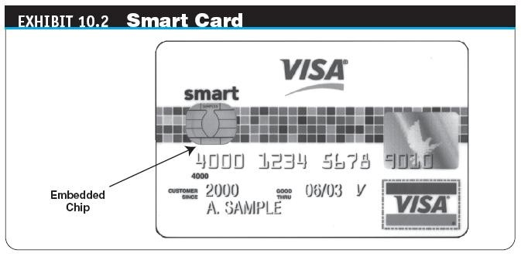

Slide 12

Smart Cards
TYPES OF SMART CARDS
contact card
A smart card containing a small gold plate on the face that when inserted in a smart card reader makes contact and passes data to and from the embedded microchip
contactless (proximity) card
A smart card with an embedded antenna, by means of which data and applications are passed to and from a card reader unit or other device without contact between the card and the card reader

Slide 13
Smart Cards
smart card reader
Activates and reads the contents of the chip on a smart card, usually passing the information on to a host system
smart card operating system
Special system that handles file management, security, input/output (I/O), and command execution and provides an application programming interface (API) for a smart card

Slide 14
Smart Cards
APPLICATIONS OF SMART CARDS
Retail Purchases
Transit Fares

Slide 15

Stored-Value Cards
stored-value card
A card that has monetary value loaded onto it and that is usually rechargeable
Stored-value cards come in two varieties:
Closed loop are single-purpose cards issued by a specific merchant or merchant group
Open loop are multipurpose cards that can be used to make
debit transactions at a variety of retailers

Slide 16
E-Micropayments
e-micropayments
Small online payments, typically under $10
Five basic micropayment models that do not depend solely or directly on credit or debit cards
Aggregation
Direct payment
Stored value
Subscriptions
À la carte

Slide 17
E-Checking
e-check
A legally valid electronic version or representation of a paper check
Automated Clearing House (ACH) Network
A nationwide batch-oriented electronic funds transfer system that provides for the interbank clearing of electronic payments for participating financial institutions

Slide 18
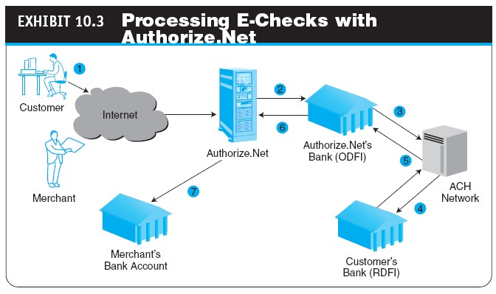

Slide 19
Mobile Payments
Mobile payment: payment transactions initiated or confirmed using a person’s cell phone or smartphone
MOBILE PROXIMITY PAYMENTS
Mobile proximity payments are used for making purchases in physical stores or transportation services.
Proximity payments involve a special mobile phone equipped with an integrated chip or smart card, a specialized reader that recognizes the chip when the chip comes within a short distance of the reader, and a network for handling the payment.

Slide 20
Mobile Payments
MOBILE REMOTE PAYMENTS
Making Mobile Payments
The payer initiating the payment sets up an account with a mobile payment service provider (MPSP).
The user selects an item to purchase. The merchant asks for a payment.
To make the payment, the payer sends a text message (or a
command) to the MPSP that includes the dollar amount
and the receiver’s mobile phone number.

Slide 21
Mobile Payments
The MPSP receives the information and sends a message back to the payer, confirming the request and asking for the customer’s PIN.
The payer receives the request on his or her mobile device
and enters the PIN.
After the MPSP receives the payer’s PIN, money is
transferred to the receiver’s account (credit card or bank account). The payer’s account is debited.
After the transaction occurs, the payment information is sent to the payer’s mobile device and his or her account at MPSP is debited.
MOBILE POS PAYMENTS

Slide 22

B2B Electronic Payments
CURRENT B2B PAYMENT PRACTICES
enterprise invoice presentment and payment (EIPP)
Presenting and paying B2B invoices online

Slide 23
B2B Electronic Payments
EIPP Models
Seller Direct
Buyer Direct
Consolidator

Slide 24

B2B Electronic Payments
EIPP Options
ACH Network
purchasing cards (p-cards)
Special-purpose payment cards issued to a company’s employees to be used solely for purchasing nonstrategic materials and services up to a preset dollar limit
Fedwire or Wire Transfer
letter of credit (L/C)
A written agreement by a bank to pay the seller, on account of the buyer, a sum of money upon presentation of certain documents

Slide 25
Managerial Issues
What payment methods should your B2C site support?
What e-micropayment strategy should your e- marketplace support?
What payment methods should the C2C marketplace
support?
Should we outsource our payment gateway service?
How secure are e-payments?
What B2B payment methods should we use?

Slide 26

Summary
Payment revolution
Using payment cards online
Smart cards
Stored-value cards
E-micropayments
E-checking
Mobile payments
B2B electronic payments

Slide 27
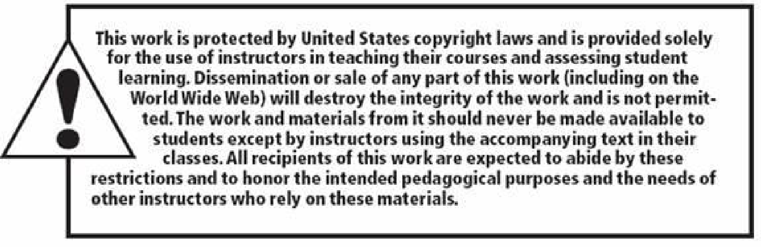




All rights reserved. No part of this publication may be reproduced, stored in a retrieval system, or transmitted, in any form or by any means, electronic, mechanical, photocopying, recording, or otherwise, without the prior written permission of the publisher. Printed in the United States of America.
Copyright © 2012 Pearson Education, Inc.
Publishing as Prentice Hall

